Slide 1
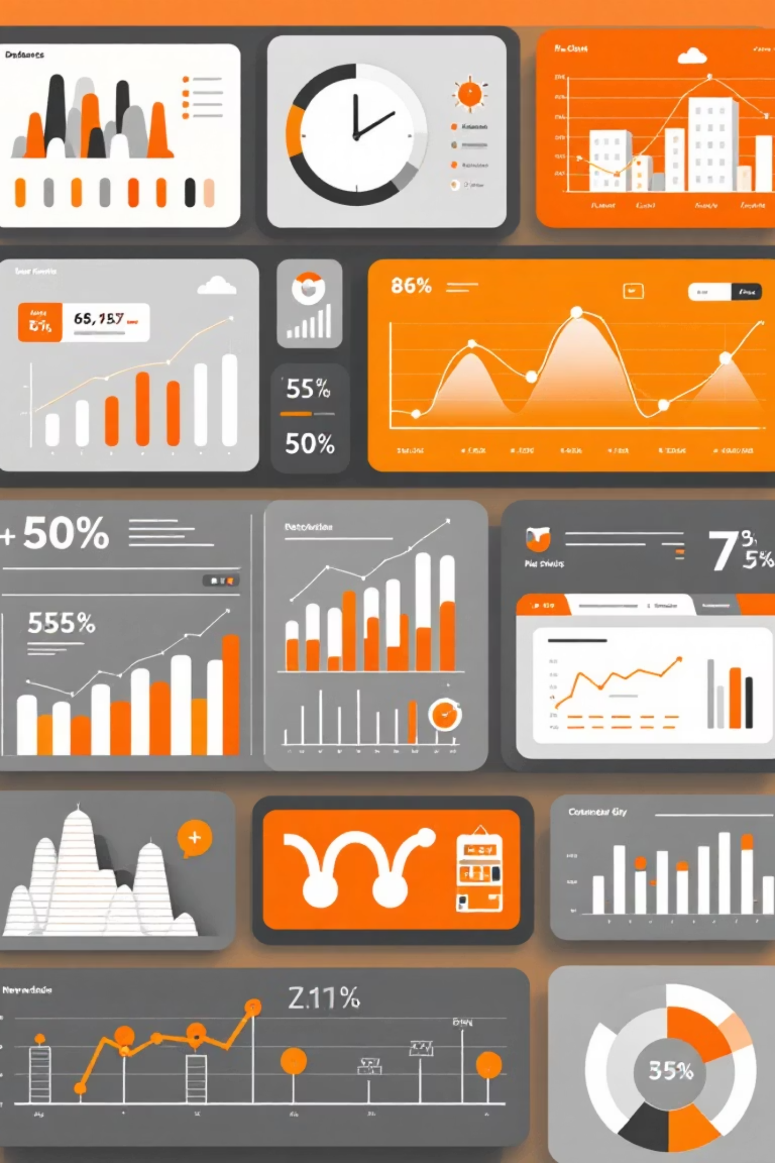
Customer Shopping Behavior Analysis
Analyzing 3,900 purchases to uncover insights into spending patterns, customer segments, and product preferences that drive strategic business decisions.

Slide 2
Dataset Overview
3,900
18
50
25
Total Purchases
Data Features
Locations
Product Types
Transactions analyzed across all categories
Comprehensive customer and purchase attributes
Geographic coverage across customer base
Diverse inventory across four categories
Customer Demographics
Shopping Behavior
Age, Gender, Location
Discount & Promo Usage
Subscription Status
Review Ratings
Purchase History
Shipping Preferences

Slide 3

Data Preparation & Cleaning
01
Data Loading & Exploration
Imported dataset using pandas, examined structure with df.info() and summary statistics
02
Missing Data Handling
Imputed 37 missing Review Rating values using median rating per product category
03
Feature Engineering
Created age_group bins and purchase_frequency_days columns for deeper analysis
04
Database Integration
Connected to PostgreSQL and loaded cleaned data for SQL business analysis

Slide 4
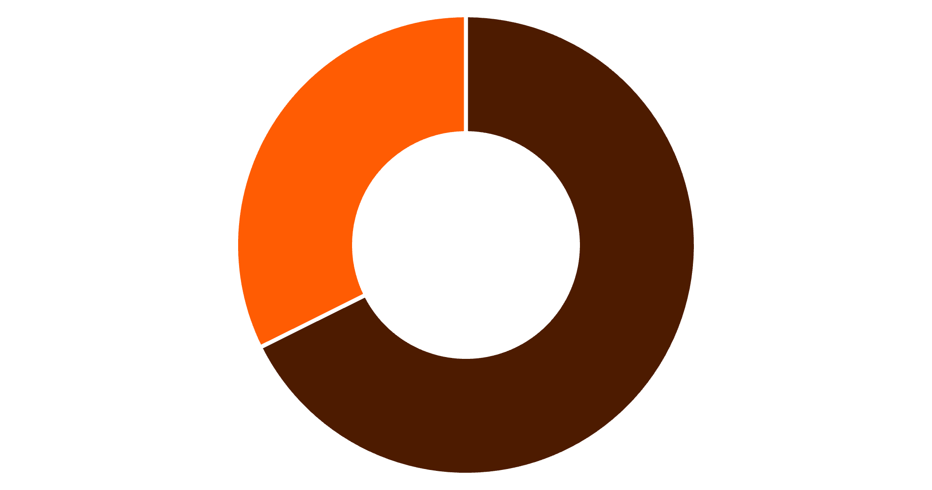
Revenue Insights by Gender
Male Customers Drive Revenue
Male customers generated $157,890 in total revenue, more than double the $75,191 from female customers.
This significant gap suggests opportunities for targeted marketing to balance gender engagement.
Male
Female

Slide 5

Discount Strategy Analysis
High-Spending Discount Users
Discount-Dependent Products
839 customers used discounts but still spent above average purchase amount
Hats lead at 50% discount rate, followed by Sneakers at 49.66%
Strategic Opportunity
Balance promotional sales boosts with margin control to optimize profitability

Slide 6
Top-Rated Products
77%
77%
76%
Gloves
Sandals
Boots
Highest average rating at 3.86 stars
Strong performance at 3.84 stars
Solid rating of 3.82 stars
76%
76%
Hat
Skirt
Customer favorite at 3.80 stars
Consistent quality at 3.78 stars
Highlight these top-rated products in marketing campaigns to drive conversions and build trust with new customers.

Slide 7
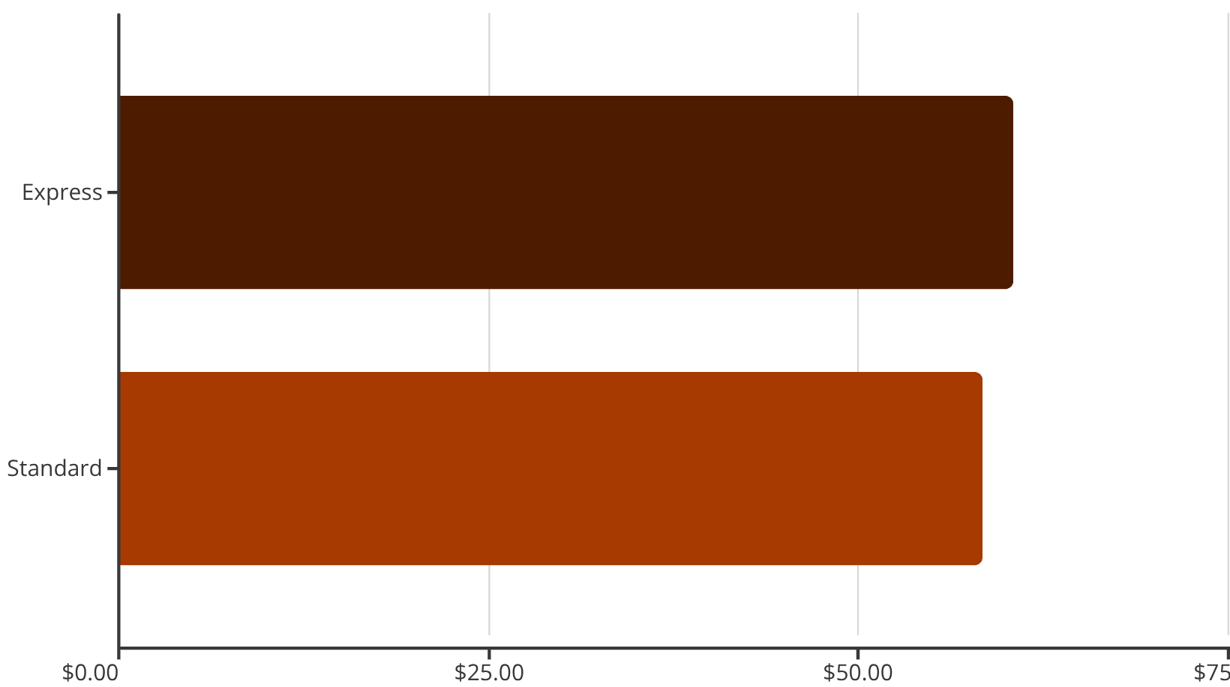
Shipping & Subscription Patterns
Shipping Type Comparison
Subscription Status Impact
Subscribers: 1,053 customers, $59.49 avg spend
Non-subscribers: 2,847 customers, $59.87 avg spend
Total subscriber revenue: $62,645
Total non-subscriber revenue: $170,436
Massive opportunity to convert non-subscribers and boost recurring revenue.
Express shipping users spend slightly more on average, suggesting premium service attracts higher-value customers.

Slide 8



Customer Segmentation
Loyal
1
3,116 customers
Returning
2
701 customers
New
3
83 customers
Repeat Buyer Insights
Growth Opportunity
Among customers with 5+ purchases: 958 are subscribers while 2,518 are not.
Implement loyalty programs to move returning customers into the loyal segment and convert repeat buyers to subscribers.

Slide 9
Category Performance
Clothing Leaders
Accessories Top Picks
Footwear Favorites
Outerwear Essentials
Blouse (171 orders), Pants (171), and Shirt (169) dominate the category
Jewelry (171 orders), Sunglasses (161), and Belt (161) lead sales
Sandals (160 orders), Shoes (150), and Sneakers (145) drive category revenue
Jacket (163 orders) and Coat (161) are customer staples

Slide 10





Strategic Recommendations
Boost Subscriptions
Promote exclusive benefits to convert the 2,847 non-subscribers, especially repeat buyers
Loyalty Programs
Reward returning customers to accelerate their journey into the loyal segment
Targeted Marketing
Focus on high-revenue age groups and express-shipping users for premium campaigns
Key Insight: Young Adults generated $62,143 in revenue, leading all age groups. Combined with product positioning of top-rated items, these strategies will maximize ROI and customer lifetime value.

